Slide 1
Lecture 12 - Sampling Methods
DS 4400: Machine Learning and Data Mining 1

Slide 2
Today
Today
Previously
Law of Large #
Sampling (Intro)
Inversion
Rejection
Importance
KDE
Summary/Practice

Slide 3
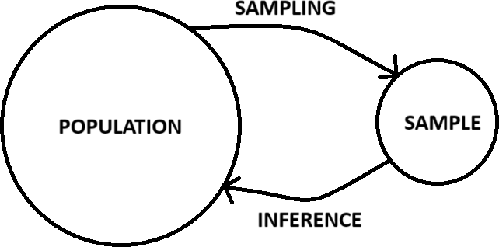





















Inference

Slide 4
Monte Carlo Sampling Methods:
Monte Carlo sampling refers to drawing samples from a probability distribution to approximate expectations, integrals, or complex distributions.

Slide 5
Monte Carlo Sampling methods that we will study in this class
Inversion Sampling
Rejection Sampling
Importance Sampling
Kernel Density Estimation (KDE) Sampling

Slide 6
The name Monte Carlo comes from the famous Monte Carlo Casino in Monaco, known for its games of chance.
The term was coined by Stanislaw Ulam and John von Neumann in the 1940s when they were working on nuclear simulations for the Manhattan Project (the project that developed the first nuclear weapons).
Ulam was trying to solve complex probabilistic problems related to neutron diffusion but found that direct computation was infeasible. He realized that by using random sampling, he could approximate solutions efficiently.
The name "Monte Carlo" was suggested by Nicholas Metropolis. It was chosen because the method uses random sampling, much like games of chance, and is a nod to the Monte Carlo Casino in Monaco

Slide 7
These Methods Are "Monte Carlo” because?
They rely on random sampling instead of direct computation.
They approximate solutions numerically instead of solving equations explicitly.
They enable estimation of complex distributions where direct sampling is difficult or impossible.

Slide 8
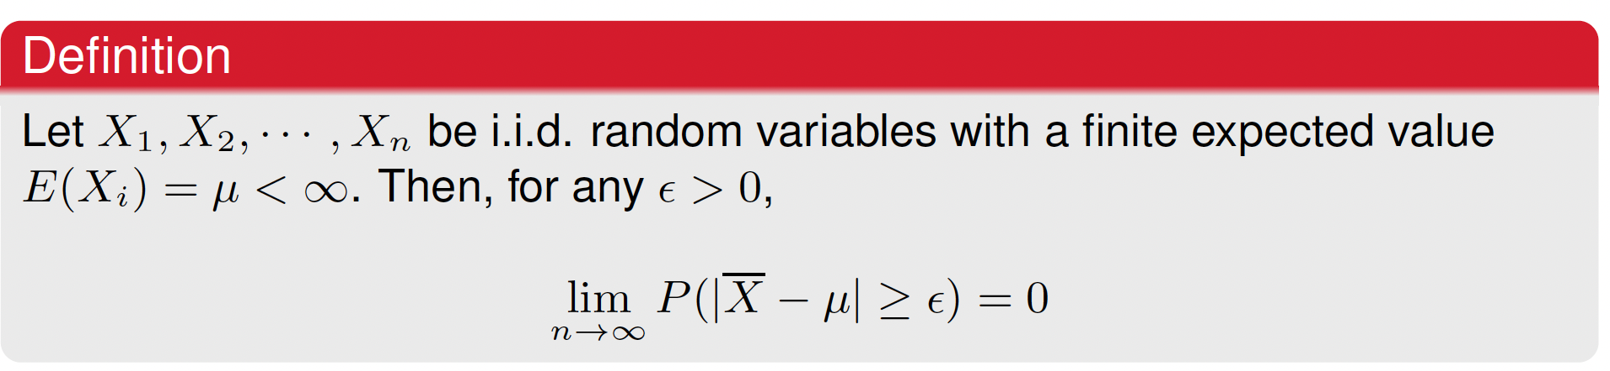





The Law of Large Numbers
This means that as n→∞, the probability that the sample mean deviates from the true mean μ by more than ϵ approaches zero.

Slide 9




Using the Law of Large Numbers to Approximate Integrals
The Law of Large Numbers (LLN) states that the sample average of a sufficiently large number of independent and identically distributed (i.i.d.) random variables converges to the expected value of the distribution.
The Expectation:
For a continuous random variable X with probability density function (PDF) p(x), the expectation of a function f(X) is given by:
This expectation represents the average value of f(X) over many samples drawn from p(x).

Slide 10

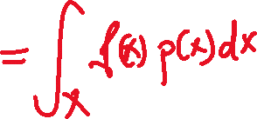


Using the Law of Large Numbers to Approximate Integrals
Step 2: Approximation of the Expectation Using Samples:
If we take a large number n of i.i.d. samples x1,x2,…,xn​ from p(x), then by the Law of Large Numbers:
This means that for a large enough sample size n, the sum of function evaluations f(xi) divided by n is a good approximation of the integral.

Slide 11
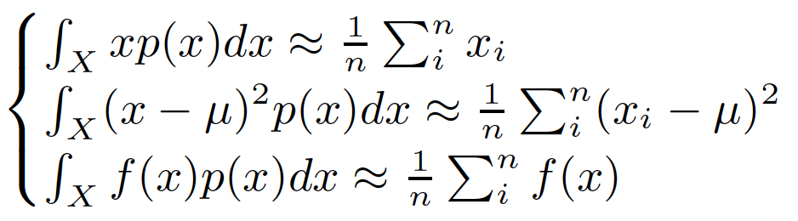



Using the Law of Large Numbers to Approximate Integrals
Special cases

Slide 12
Practical Importance of LLNs:
Widely used in numerical integration and statistical inference.
It shows that instead of dealing with complex integrals, we can rely on simple summation over sample data.
In Simple Terms:
Integrals involving p(x) can be replaced by averaging over samples.
This is powerful because it allows us to approximate complex expectations using data alone.

Slide 13
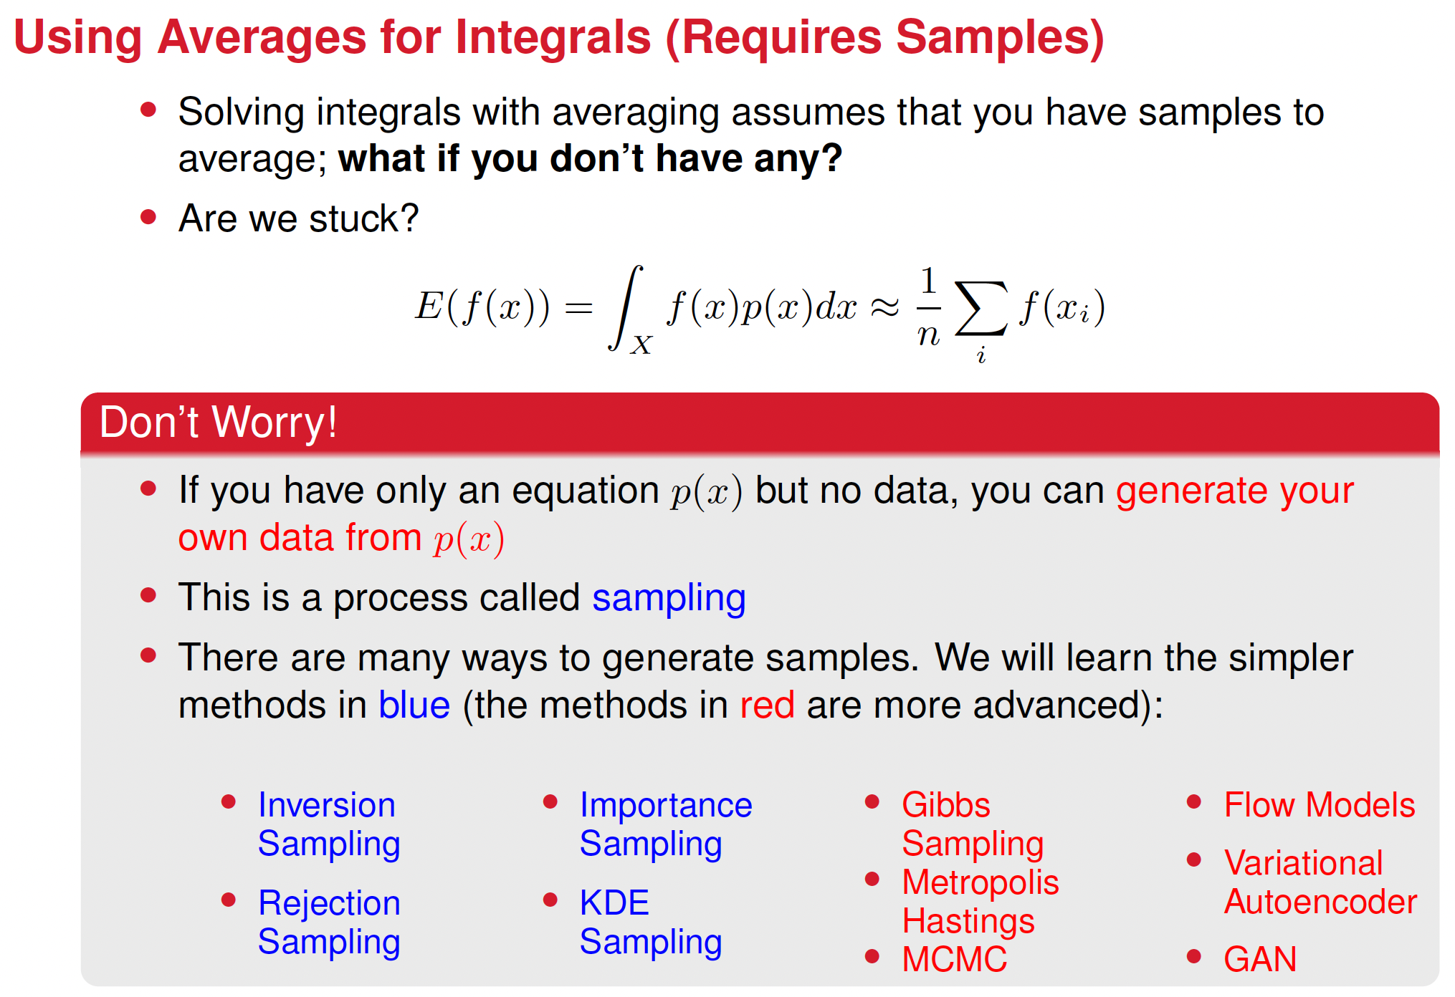









Slide 14



Inversion Sampling
GOAL: to sample from a complex p(x)
ASSUME: we can at least sample from a simple continuous uniform distribution between 0 and 1
KEY OPERATION: using the inverse of the cumulative distribution function

Slide 15
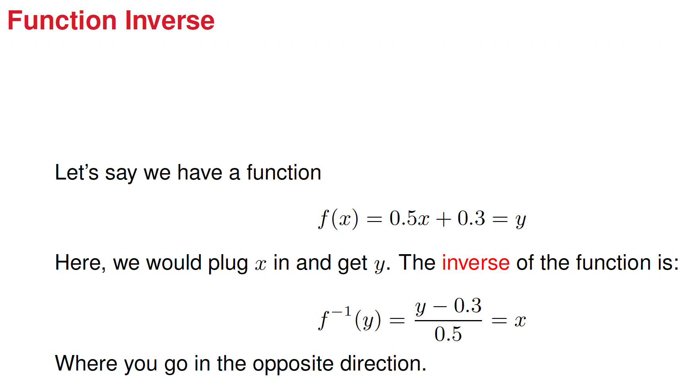



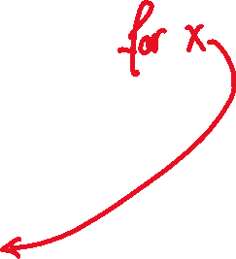


Slide 16
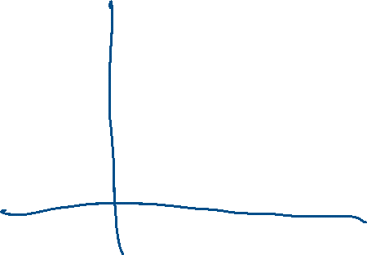

The cumulative distribution function

Slide 17







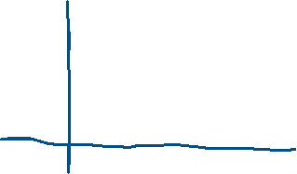









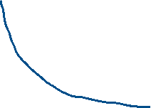


The cumulative distribution function
The Cumulative Distribution Function (CDF), denoted as F(x), gives the probability that a random variable X takes a value less than or equal to x:
The CDF is obtained by integrating the probability density function (PDF):
f(x) is the probability density function.

Slide 18
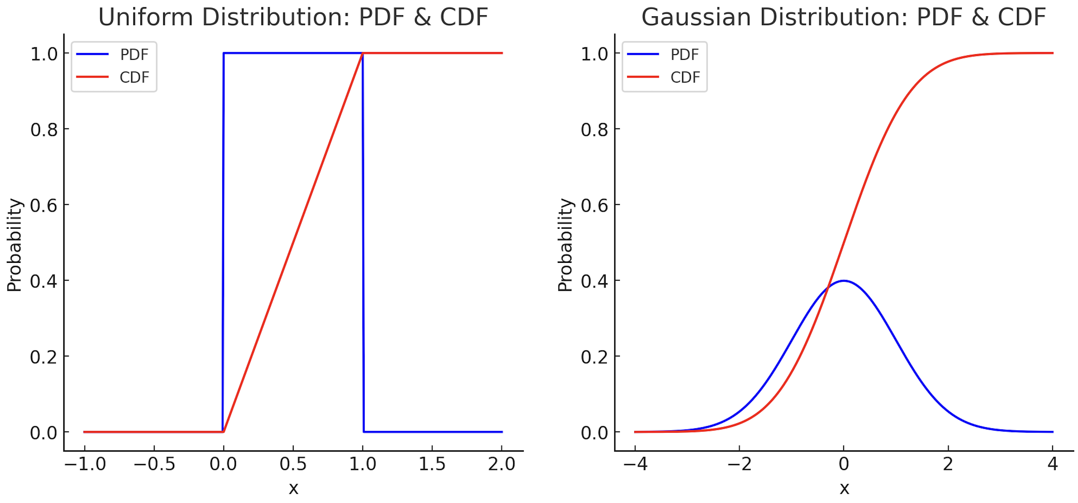







The CDF for a uniform and for the Gaussian distribution

Slide 19
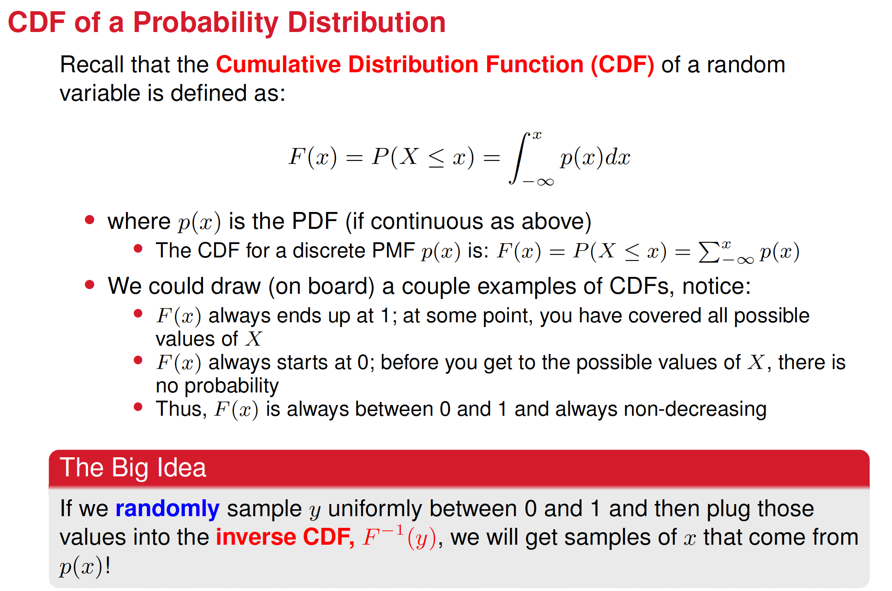




Slide 20
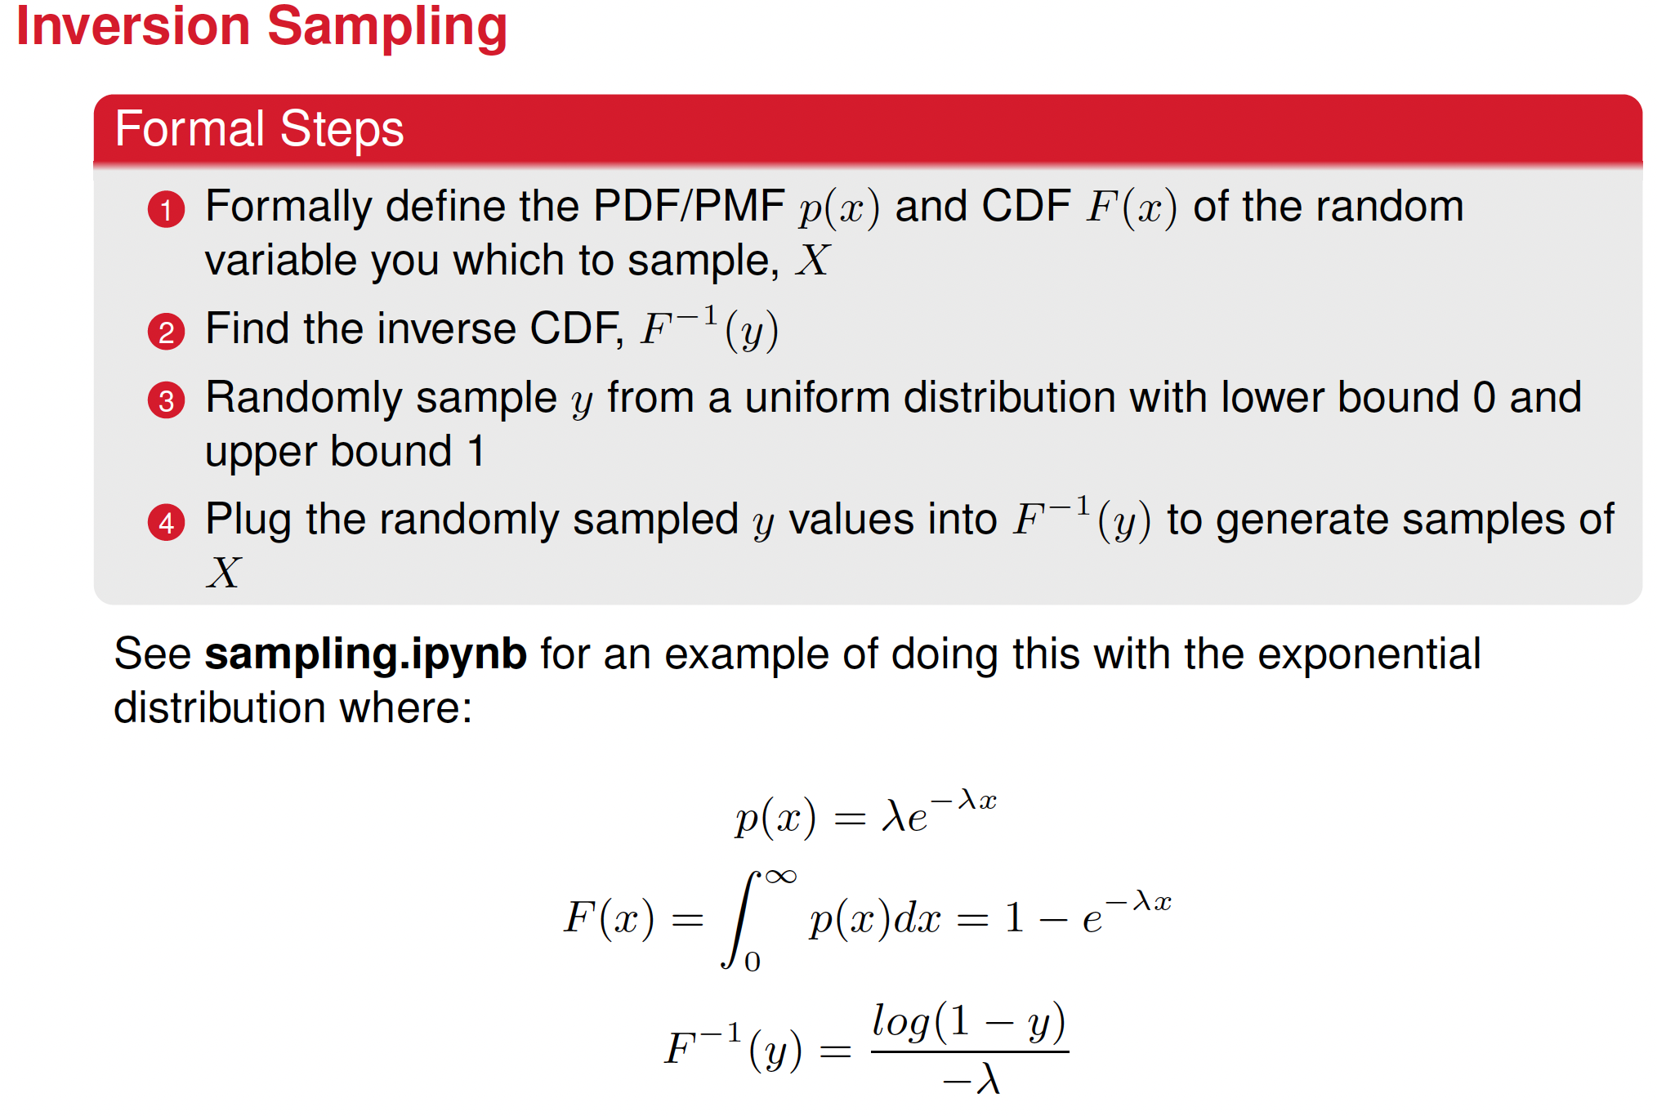
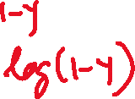











Slide 21
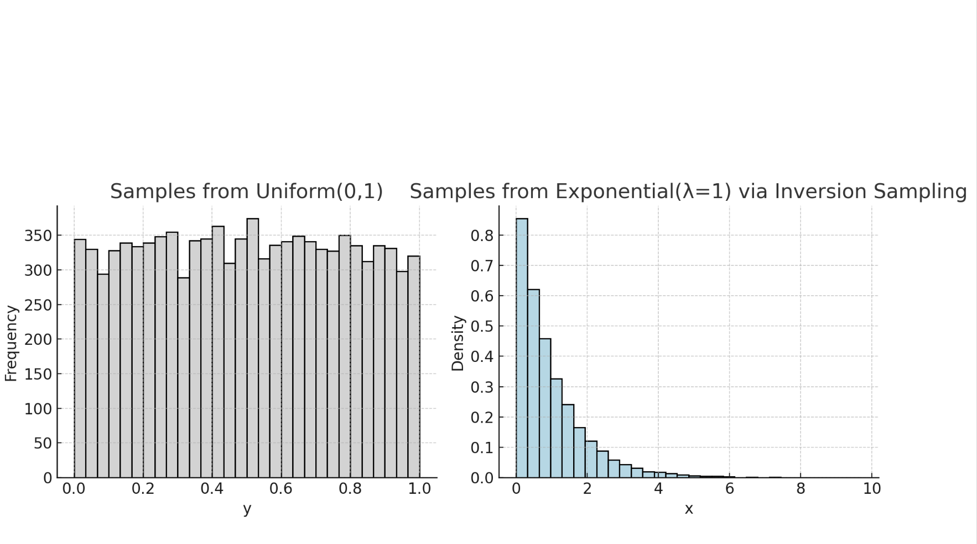

Slide 22
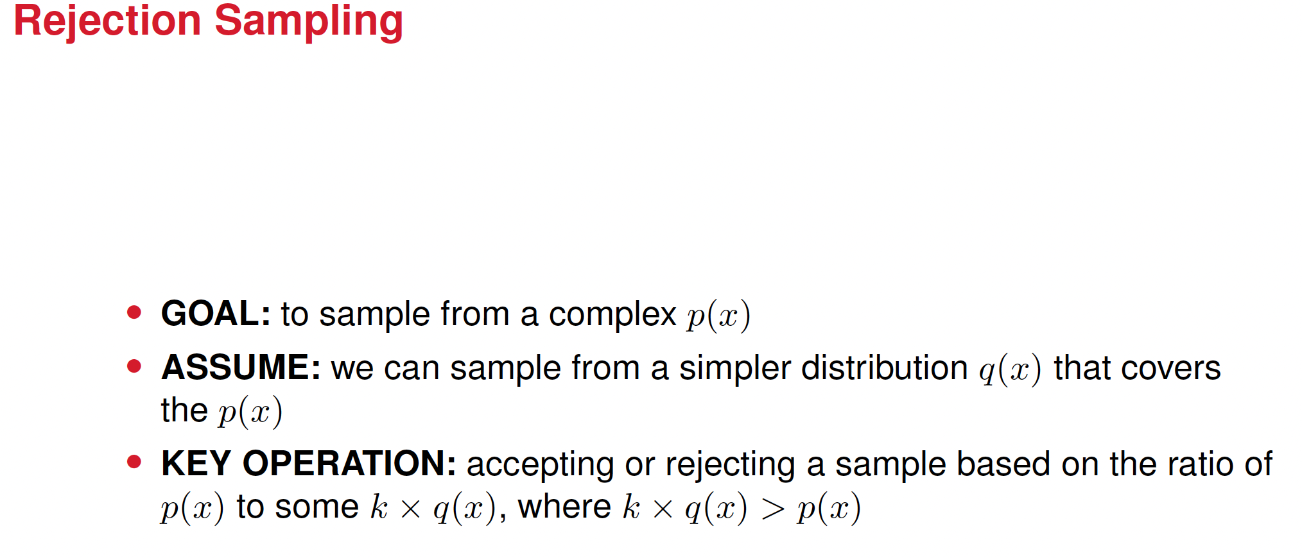

Slide 23
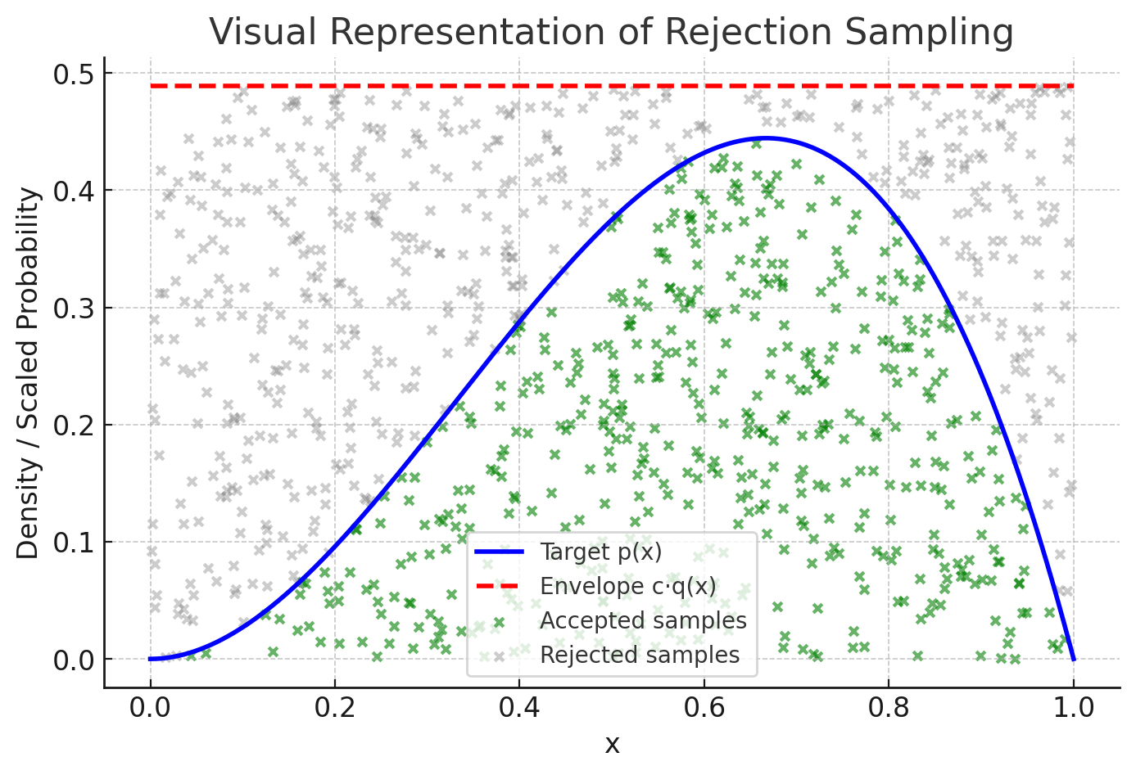

Slide 24
Rejection Sampling Steps
The goal is to generate samples from a difficult target distribution p(x) using an easier proposal q(x).
Steps
1. Choose a proposal distribution q(x) and a constant M ≥ maxₓ [p(x)/q(x)].
2. Sample a candidate x ∼ q(x).
3. Draw a uniform random number u ∼ U(0,1).
4. Accept x if u ≤ p(x) / (M q(x)); otherwise, reject it.
5. Repeat until enough samples are accepted.
Intuition:
Draw points under Mq(x); keep those that fall below p(x). Accepted points follow p(x).

Slide 25




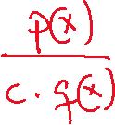
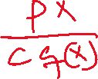
Why it works?
Given a distribution p(x) that we wish to sample using the rejection method, the probability of accepting a point drawn from q(x) is the joint probability of choosing a point from q(x) and accepting it. That’s:
Now, that expression is simplified as:
So, except for the constant c, the probability of acceptance is the same as p(x)

Slide 26









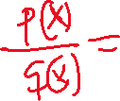














How to choose c
• Analytical: c = max_x (p(x)/q(x))
• Empirical: estimate max(p/q) from samples, and multiply by 1.1 for safety
• Acceptance rate = 1/c, smaller c means higher efficiency
Example, determining c for the exponential function

Slide 27
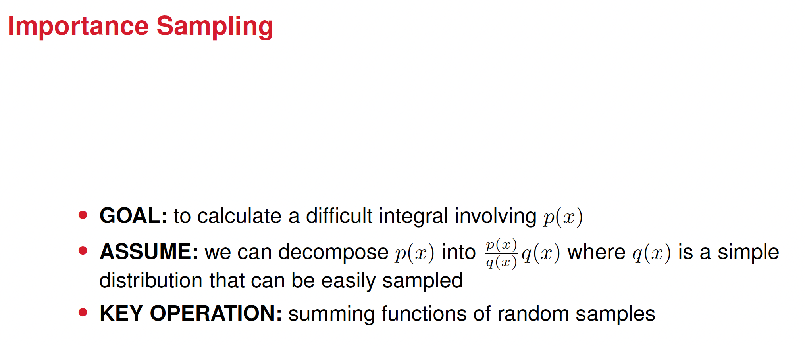

Slide 28







Step 1 - Expectation Integral
We want to compute the expectation of a function f(x) under a probability distribution p(x)
Assume that this integral is difficult to compute directly as p(x) is hard to sample from.
Step 2 - Introducing a Proposal Distribution
Instead of sampling from p(x), introduce an easier distribution q(x):
The fraction ​ acts as a correction factor to adjust for using q(x) instead of p(x).

Slide 29




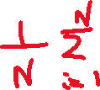




Step 3 - Monte Carlo Approximation
We approximate the integral using Monte Carlo sampling:
Steps:
Sample xi​ from q(x)
Compute importance weights w(xi)
Estimate the integral as a weighted sum.

Slide 30
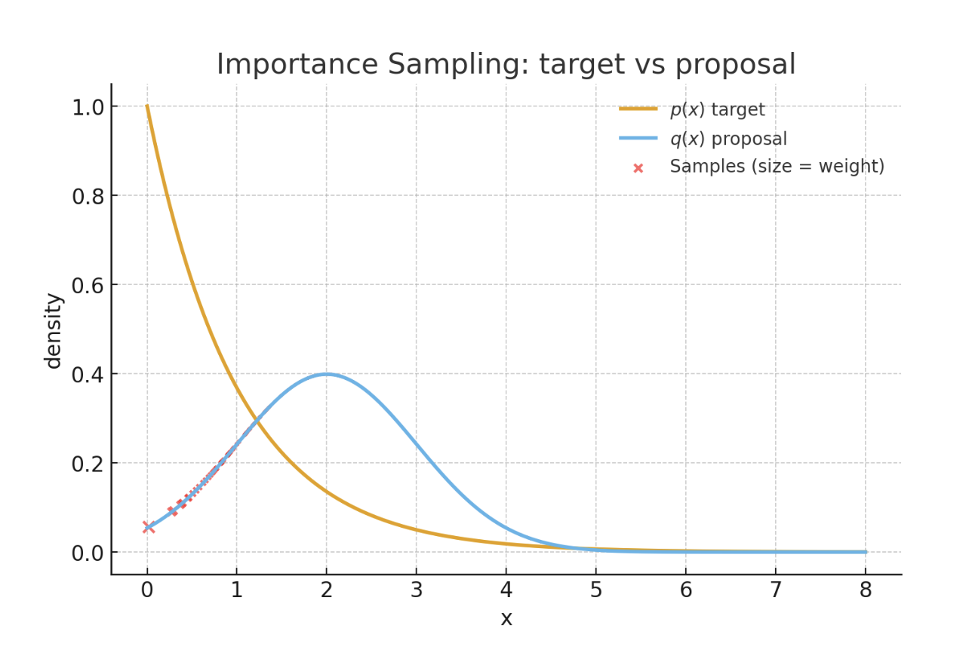

Slide 31
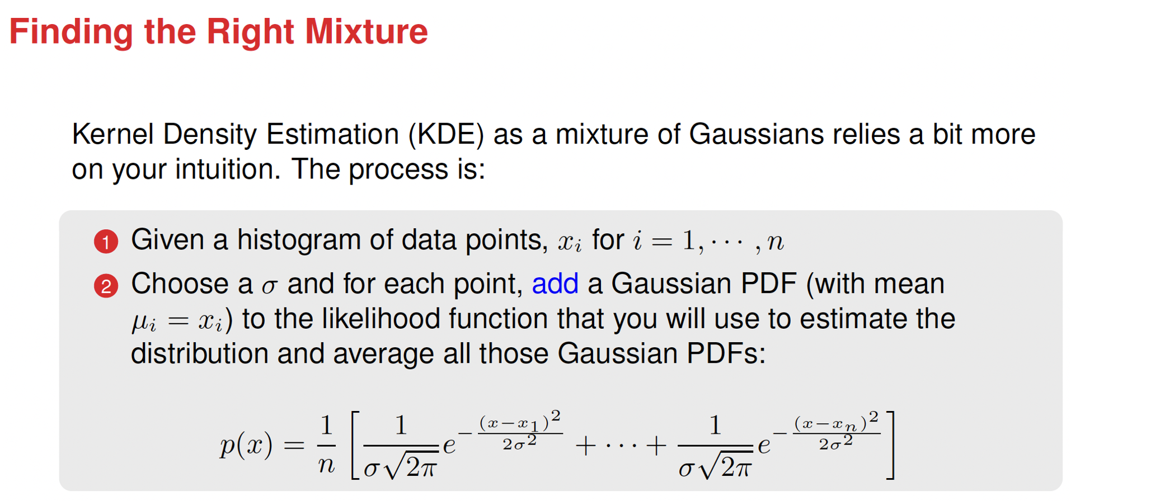
KDE relies on choosing the right smoothness (σ or bandwidth), which controls how much nearby points influence each other.

Slide 32
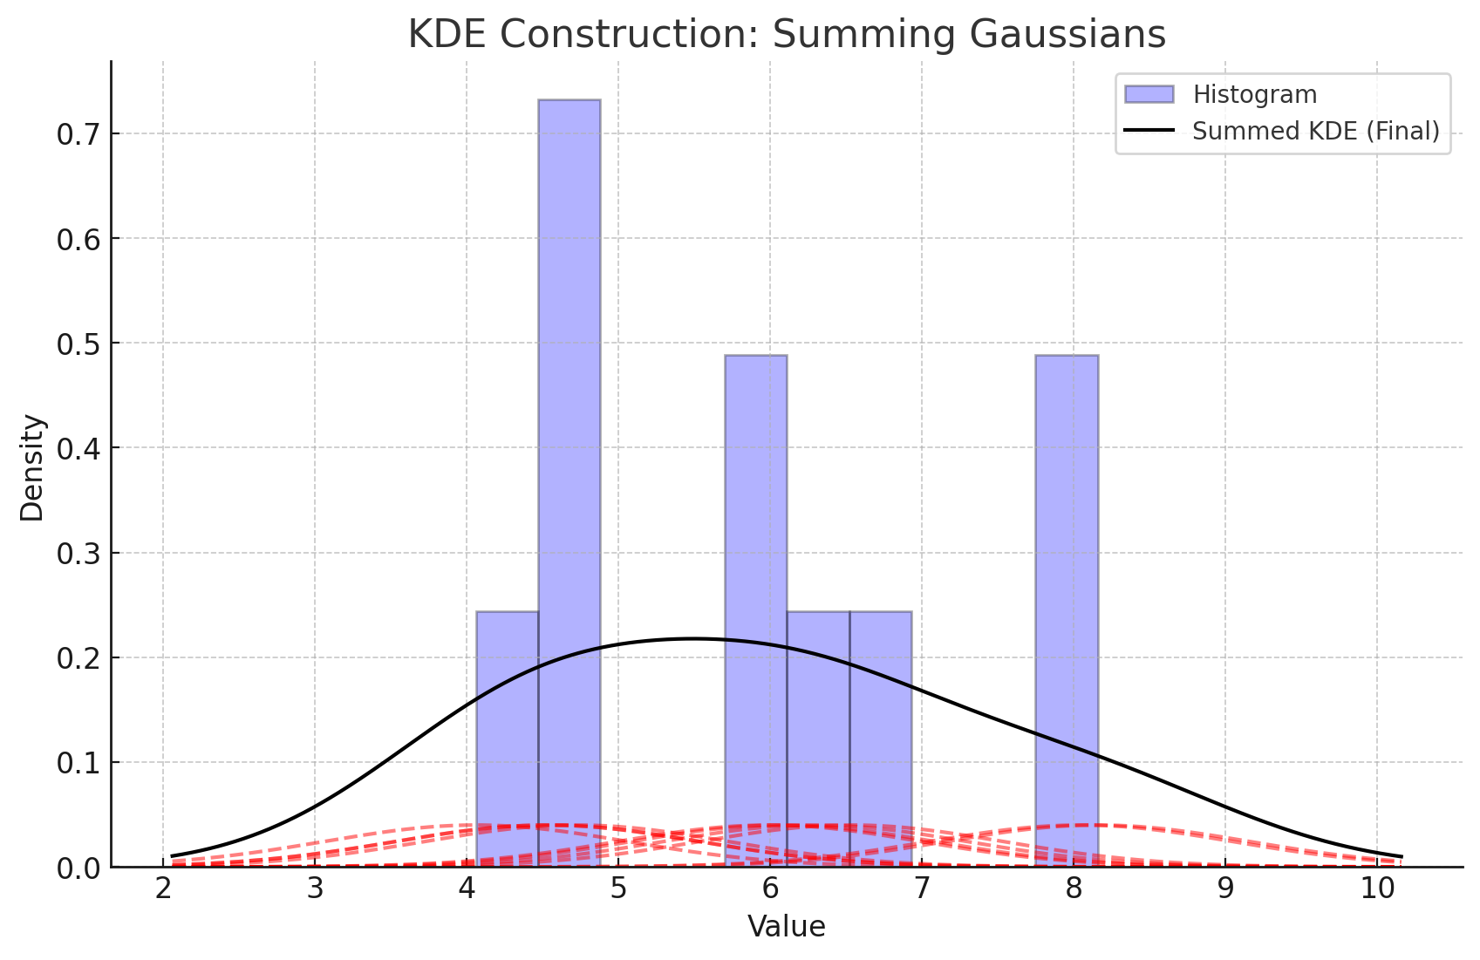
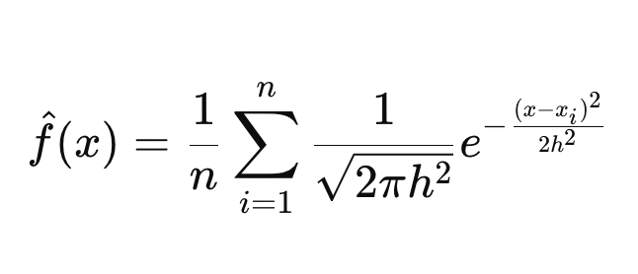
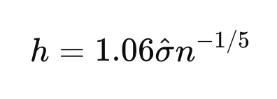
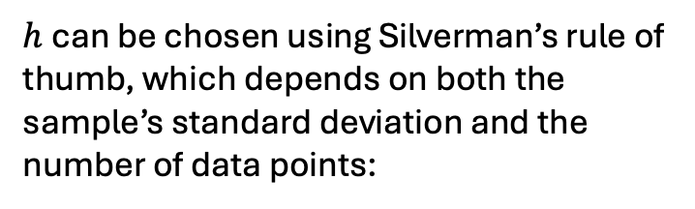
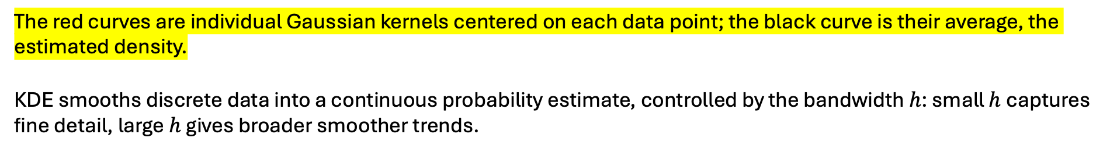
$h$can be chosen using Silverman’s rule of thumb, which depends on both the sample’s standard deviation and the number of data points:
The red curves are individual Gaussian kernels centered on each data point; the black curve is their average, the estimated density.
KDE smooths discrete data into a continuous probability estimate, controlled by the bandwidth $h$: small $h$captures fine detail, large $h$gives broader smoother trends.

Slide 33
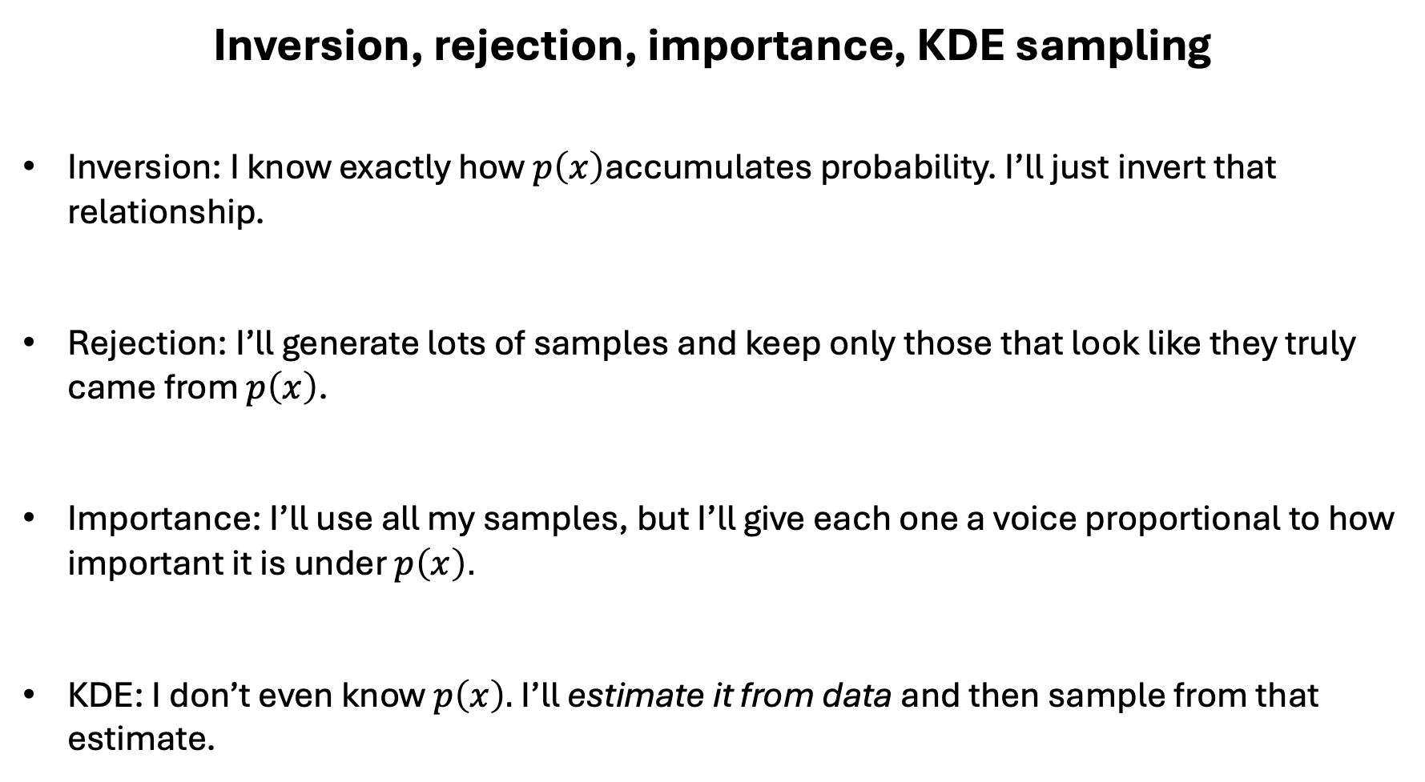
Inversion, rejection, importance, KDE sampling
Inversion: I know exactly how $p\left(x\right)$accumulates probability. I’ll just invert that relationship.
Rejection: I’ll generate lots of samples and keep only those that look like they truly came from $p\left(x\right)$.
Importance: I’ll use all my samples, but I’ll give each one a voice proportional to how important it is under $p\left(x\right)$.
KDE: I don’t even know $p\left(x\right).$I’ll estimate it from data and then sample from that estimate.

